Slide 1
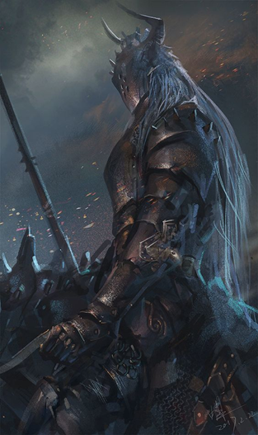
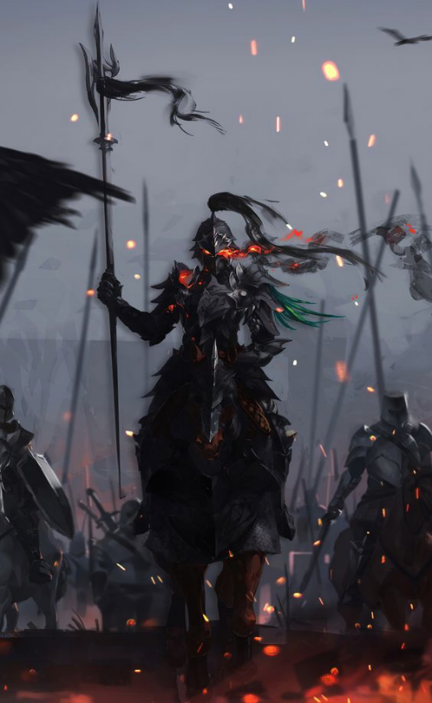
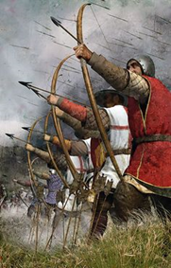
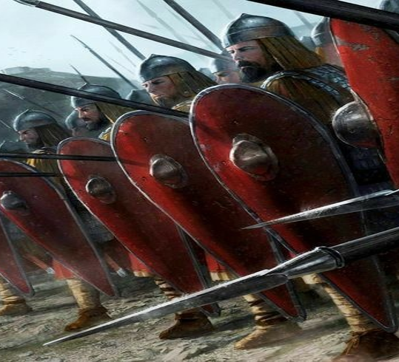
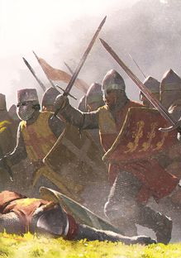



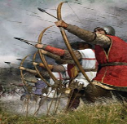




Hero
Hero
archer
phalanx
Vanguard
4
4
4
4
2
2
1
2
2
1
archer
archer
archer
phalanx
archer
4
2
2
2
2
2
2
1
2
2
2

Slide 2


Slide 3
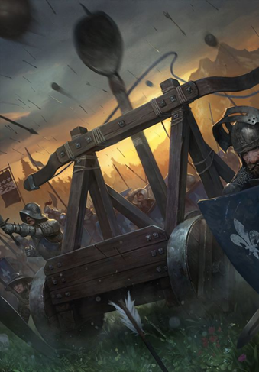
catapult
catapult
catapult
catapult
catapult
3
0
3
0
3
0
3
0
3
0
phalanx
phalanx
phalanx
phalanx
phalanx
4
1
2
1
2
1
2
1
2
1
2

Slide 5
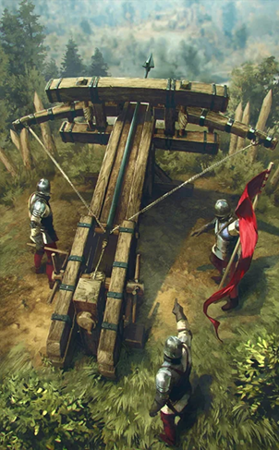
catapult
ballista
ballista
ballista
ballista
3
0
0
3
0
3
0
3
0
3
Vanguard
Vanguard
Vanguard
Vanguard
Vanguard
2
1
2
1
2
1
2
1
2
1

Slide 7
Vanguard
Vanguard
Vanguard
Vanguard
Vanguard
2
1
2
1
2
1
2
1
2
1
Vanguard
Vanguard
Vanguard
Vanguard
Vanguard
2
1
2
1
2
1
2
1
2
1

Slide 9



Slide 10


Slide 12
